Slide 1
100476935
Bsc Computer Science (with hons)

Slide 2
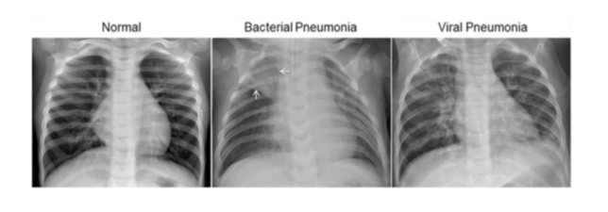
The Chosen Dataset
Chest x-ray images (pneumonia)
Why did I select this dataset?
More clearly defined scope.
Focus on computational efficiency
Personal interest in AI with a goal of clinical impact.
Professional growth relevant to my field.
Data availability
More tangible application.
More tangible impact on field (looking into capsule networks).

Slide 3
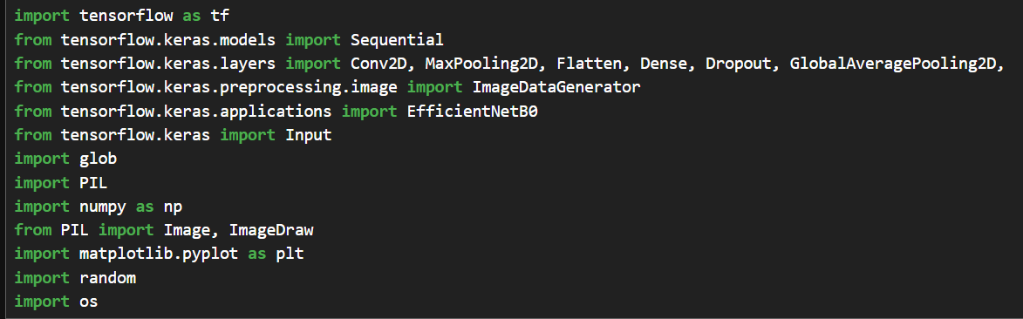
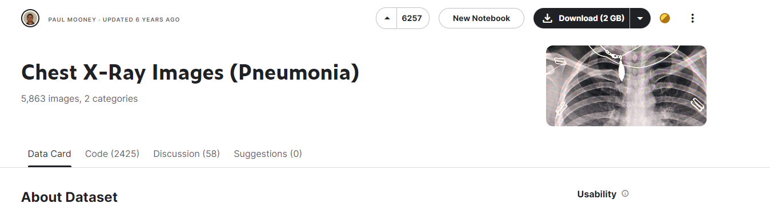
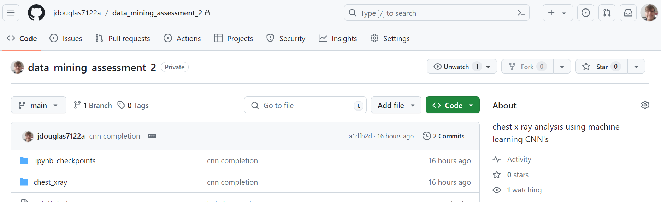
Project Prerequisites
Packages:
Download of the dataset from Kaggle:
Setup of Git Repository:

Slide 4
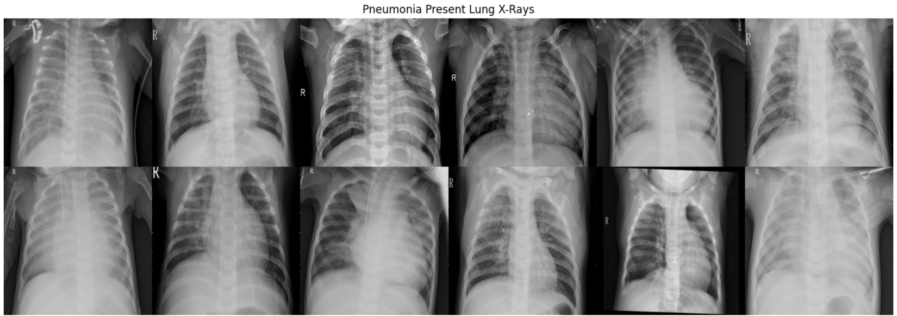
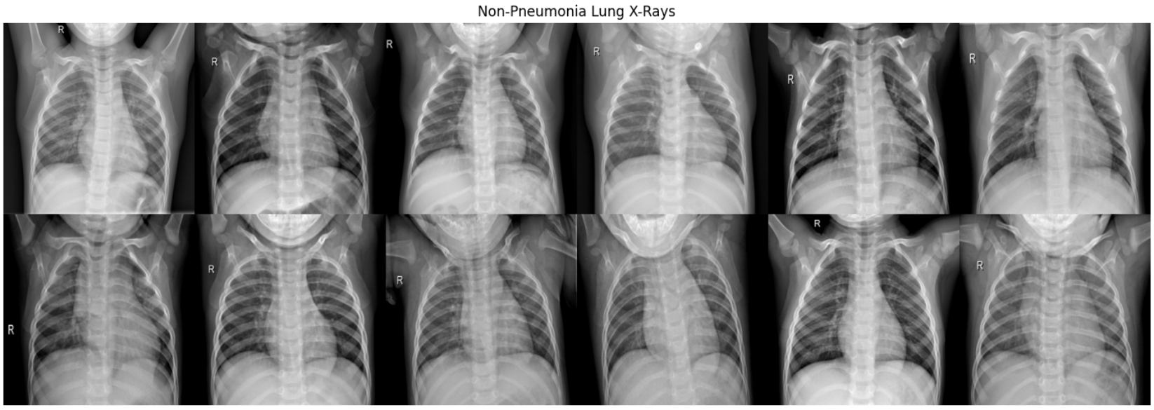
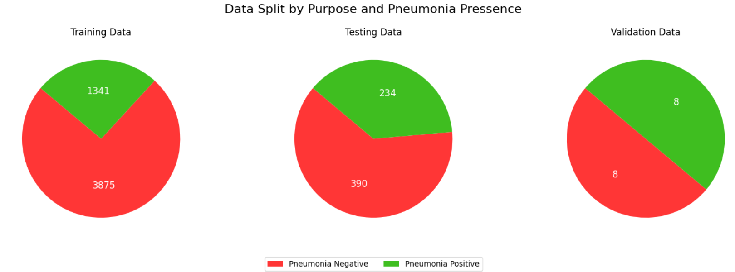
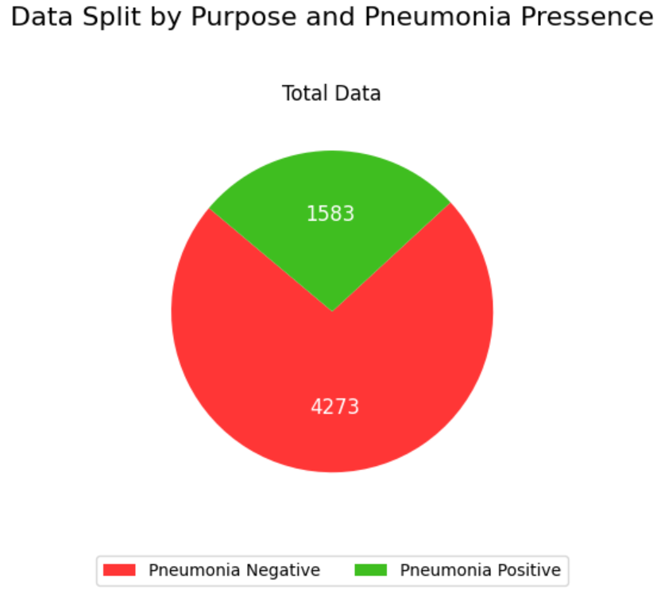
Exploratory Data Analysis
Features that might indicate pneumonia:
Consolidation (areas of white in the lung)
Cavitation (Cavities in the lung)
Air Bronchograms (alveoli filled with fluid making bronchi more visible and dark)
Pleural Effusion (Nonspecific to pneumonia, excess fluid in the pleural space, the thin fluid filled space between two pulmonary pleurae of each lung)
Preibronichal thickening
Volume loss (collapse of lung tissue)
Interstitial patterns (more diffuse, reticular pattern)
Clear Skew towards non-pneumonia Cases
Considerations for pre-processing:
Image transformation to prevent overfitting
Pixel density
Colour palette
Anomalies
Image Dimensions
Image Noise
Metadata Analysis

Slide 5
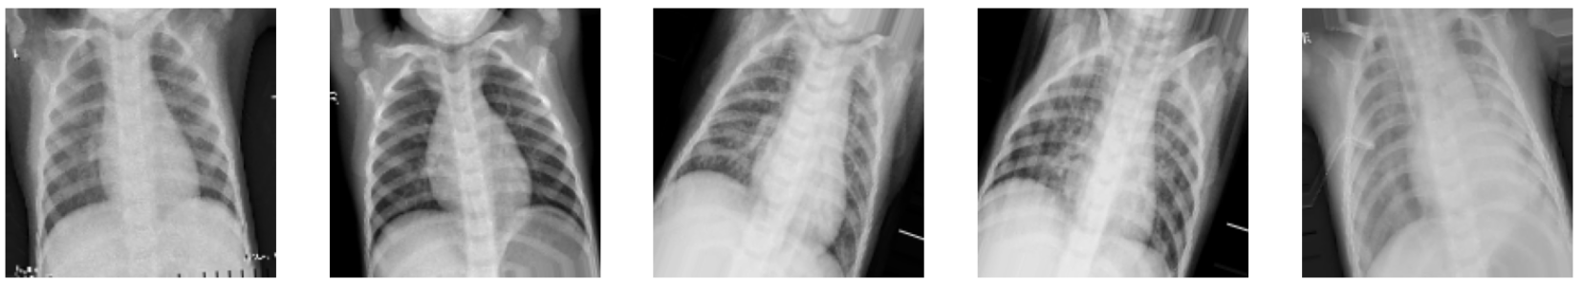
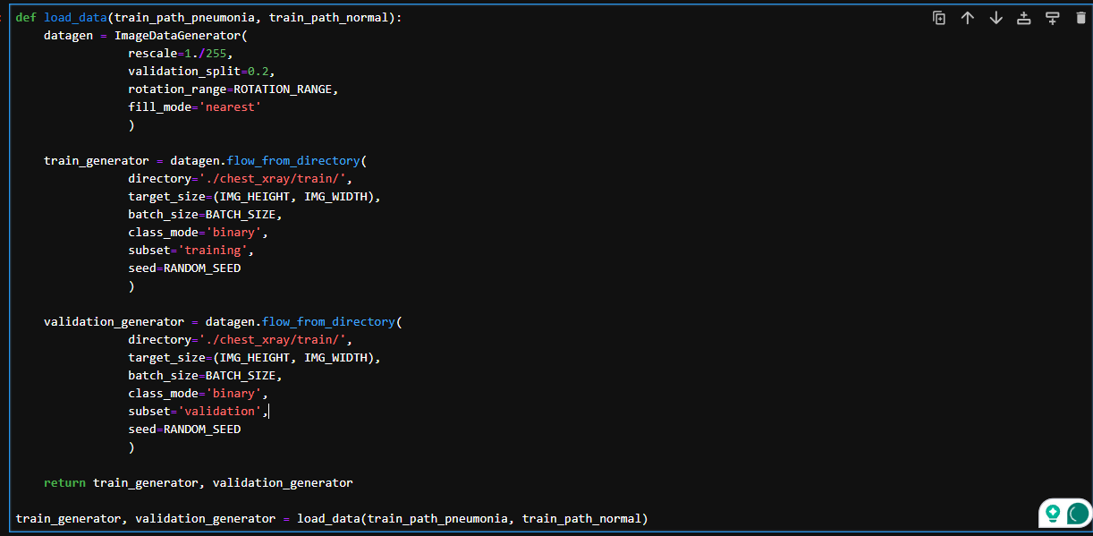
Pre-Processing
Normalization of image dimensions
Image Translations:
Colour palette verification (greyscale)
Image Generator
This will apply the Translations and any further transformations to the dataset, drawing data from a given directory.
Also defines the type of class (binary) and the subset of the data (training or validation)

Slide 6
Model Selection
Can identify subtle features in the chest x-rays
Low computational cost
High efficiency
Low training time
Reduction in complexity where possible through packages such as tensorflow.keras
Likelihood to experience overfitting
Amount of work needed post training to get model results desired
Ability to integrate with other models
Robustness / generalization
Scalability
Maintenance & further training
Support

Slide 7
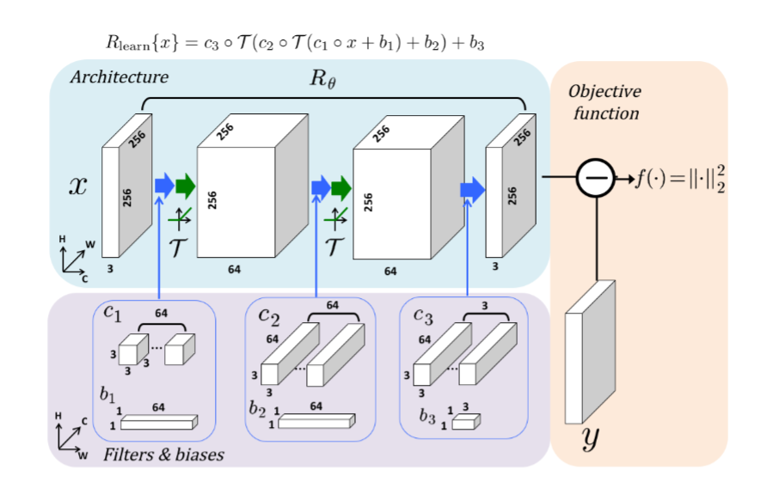

Convolutional Neural Networks
A type of deep learning algorithm that’s good at processing information with a grid like topology.
Images are converted into grids which then allows the algorithm to convolve over, generating feature maps which indicate a true or false value in binary classification.
Pooling takes individual samples and summarises them based on a frame value.
Activation functions take the pooled data outputted from the previous layers, and determines which data is passed to the proceeding layer.
Dense layers calculate a weighted sum of its inputs to help with decisions or predictions
Dropout Layers regularize the data by periodically 0’ing output from neurons to prevent co learning, encouraging learning different paths through neuron activation.
S. Premanand (2021) Convolution Neural Network – CNN Illustrated with 1-D ECG Signal, AnalyticsVidhya https://www.analyticsvidhya.com/blog/2021/07/convolution-neural-network-the-base-for-many-deep-learning-algorithms-cnn-illustrated-by-1-d-ecg-signal-physionet/
M.T. McCann Et al,. (2017) Convolutional Neural Networks Inverse Problems in Imaging: a Review, IEEE Signal Processing Magazine, 34, 85-95

Slide 8
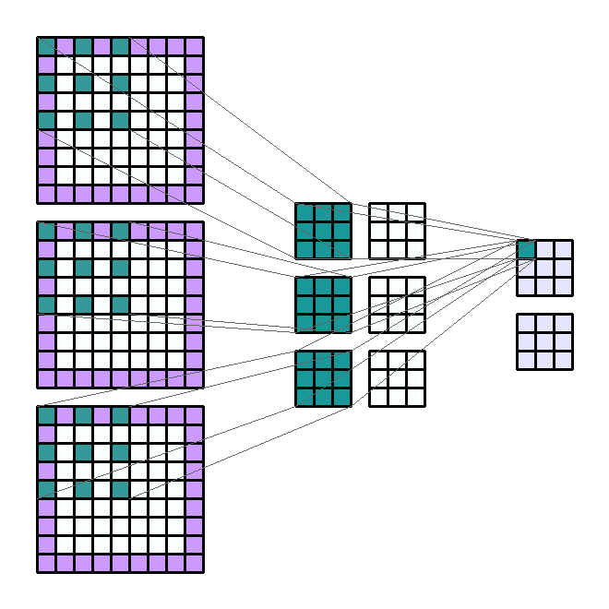
CNN Layers Explained: Conv2D
A. Thevenot (2020) Conv2D: Finally Understand What Happens in the Forward Pass, Medium https://towardsdatascience.com/conv2d-to-finally-understand-what-happens-in-the-forward-pass-1bbaafb0b148
Notes:
Imagine you have a small clear stencil which you place over the paper, but the stencil can only see a small portion of the picture at a time, as you slide this stencil across the entire picture, you try to learn specific details about sections such as edges, textures and colours, this stencil can be thought of as the filter
We slide/convolve the filter across the image at given invervals, multiply the values of the filter with the original picture
These multiplied values generate a feature map to pass to the next layer

Slide 9

CNN Layers Explained: MaxPooling2D
NumPtNet, Max Pooling Layer
https://nico-curti.github.io/NumPyNet/NumPyNet/layers/maxpool_layer.html
Notes:
Think of max pooling as a sieve which runs over the feature map, only letting through the largest chunks

Slide 10
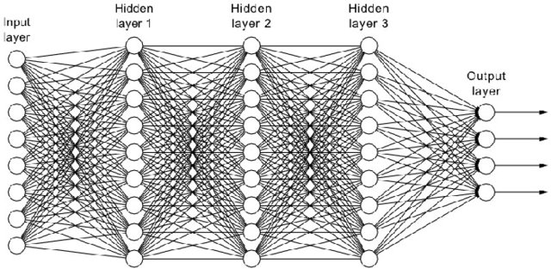
CNN Layers Explained: Dense
Y.D. Wang et al,. (2021) Deep Learning in Pore Scale Imaging and Modeling, Earth-Science Reviews, 215

Slide 11
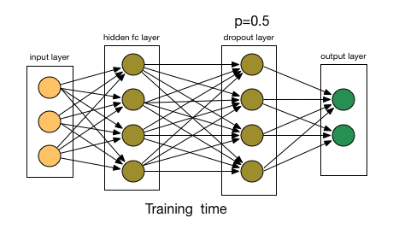
CNN Layers Explained: Dropout

Slide 12
Capsule Networks
A capsule network is an experimental type of ANN
Normal ANN’s struggle with understanding spatial hierarchy between objects()
To fix this problem, capsule networks use groups of neurons called capsules which are especially good at maintaining spatial relationships between different features of a relationship().
Within this ANN, there are multiple layers of capsules.
Uses dynamic routing of traffic.
Although exciting, these types of neural network are still very experimental and have little support among libraries such as keras, requiring a more complex understanding in order to use and fine tune.
Capsule networks are more computationally intensive than traditional neural networks, and have large scalability issues.
Notes:
!) in leymans terms, a capsule network is a team of experts where each member is responsible for understanding a specific part of a problem and knows how to efficiently communicate with other experts to build a comprehensive understanding of the entire issue.
2) For example, it doesn’t just understand the presence of an eye in an image, but its orientation, size and position relative to other features
3) Lower layer capsules detect simple features (like edges of objects) while higher level capsules combine these features to recognise more complex objects.
This allows for more complex structures to be understood in a more robust way, especially when taking into account orientation.
4) Dynamic routing decides how information should flow from lower to higher level capsules, this helps the network focus on the important spactial relationships in the image, even in unusual contexts.

Slide 13
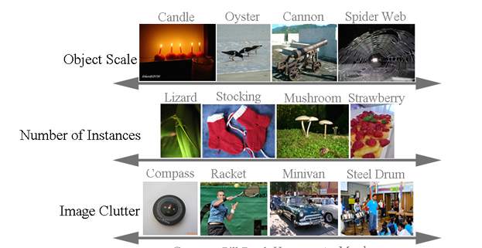
Transfer Learning with Pre-Trained Models
Uses models pre-trained on other images to try to take advantage of the patterns its previously detected applied to your problem
Reduces training time for a much more complex network.
Some Examples:
ResNet
EfficientNet
InceptionV3
Xception
VGG16 & 16
EfficientNet is trained on a database called ImageNet which consists of over 20000 categories, its specified for research of image classification.
O. Russakovsky et al,. (2015) ImageNet Large Scale Visual Recognition Challenge, arXiv:1409.0575v3

Slide 14
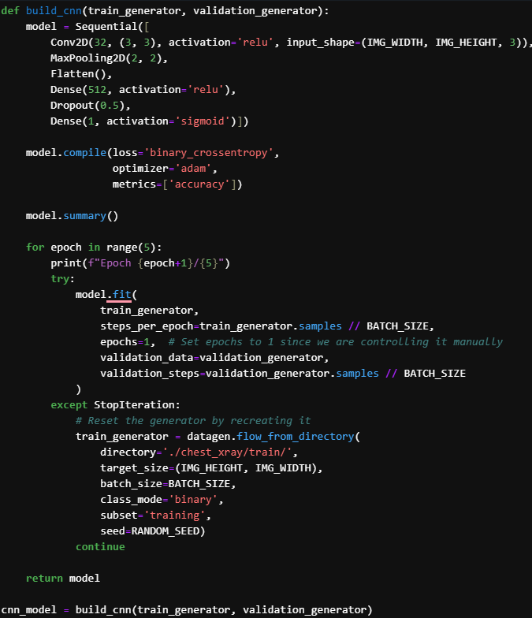
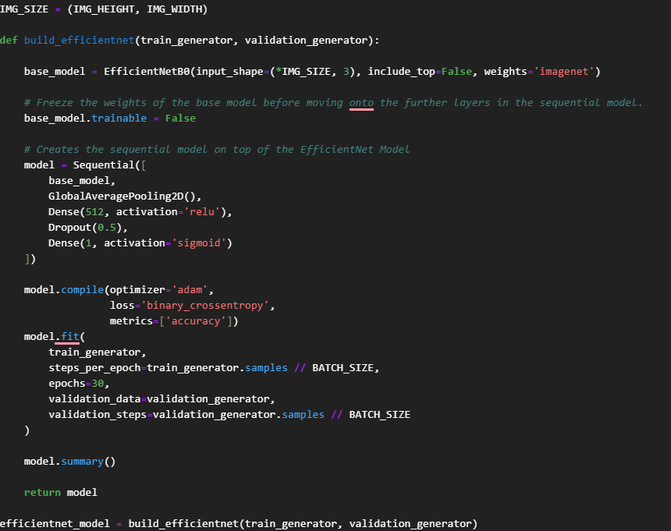
Initial Models Built

Slide 15
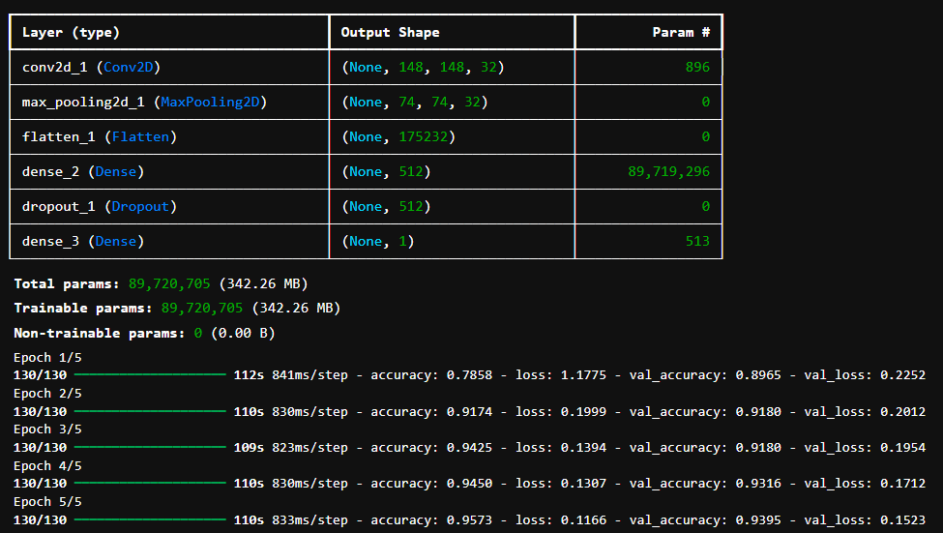
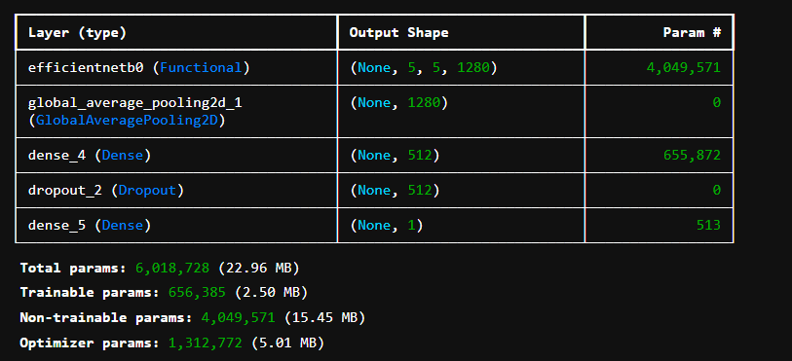
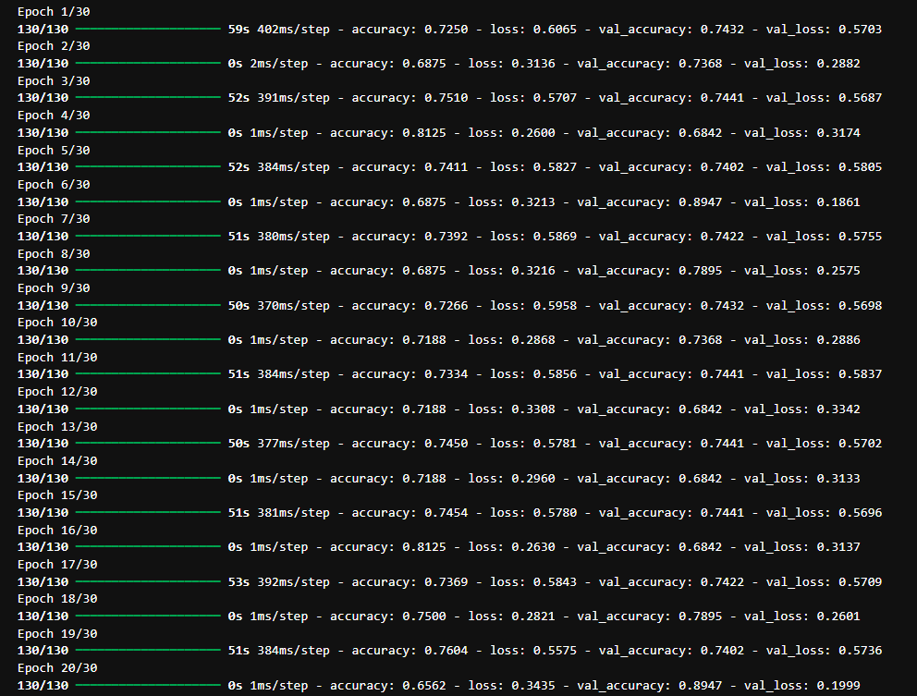
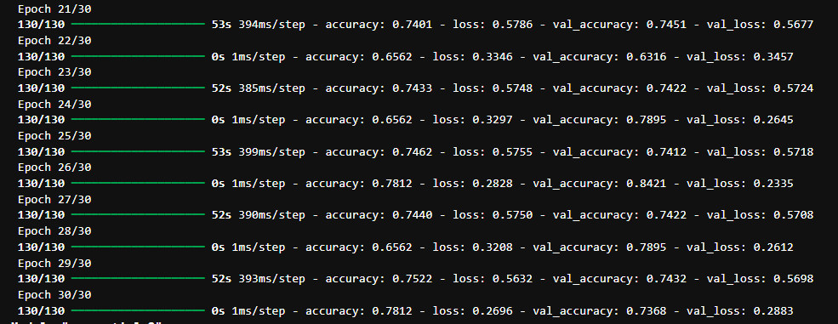
Initial Model Results
Acceptable accuracy for memory use
The training accuracy hugely fluctuates.
The validation accuracy fluctuates but shows improvement
The validation loss is not consistently decreasing
Incredible results for such a simple model
Only required 5 training epochs to get above 90% accuracy
The training time is quite significant for the simplicity of the model
The amount of memory needed for the model is quite large, this is due to the dense_2 layer.

Slide 16
Possible Model Improvements:
Data Augmentation:
Possibly using more synthetic information with even greater random transformations could make the model adapt.
Increase data volume:
Currently we are pulling all data from the training and validation set, when we have a testing set available, this may increase the model accuracy.
Learning rate:
Tweaking the rate at which the model learns may improve model stability
Add new layers:
Additional dropout layers or increasing the dropout rate may be beneficial for accuracy
Hyperparameter tuning:
including different learning rates and changing optimizer might increase accuracy
Callbacks:
Early stopping and learning rate schedulers to dynamically adjust the training process may help with the instability
Cross Validation:

